Slide 1



Consumer Goods Ad-Hoc Insights
Presented by : Jyoti Sharma

Slide 2
Content
Overview of Company
Dataset and model
Problem statement
Ad hoc request with Insights

Slide 3
Company Overview
Atliq Hardware is one of the leading computer hardware producers in India as well as 26 other countries across the globe
Manufactures products under 3 major divisions i.e., Peripherals & Accessories, PC, Networking & Storage
We have a total of 74 Customers like Neptune, Sage, Leader, Vijay Sales etc. across all markets/countries

Slide 4
Products
Internal HDD-
Graphic Card-
Processors-
Motherboard-
Peripherals
1
2
Accessories
-Mouse
-Keyboard
-Batteries
Desktop
3
4
Networking
Business Laptop-
Personal Desktop-
-Wi fi extender
Notebook
Storage
Personal Laptop-
Business Laptop-
Gaming Laptop-
5
6
-External Solid State Drives
-USB Flash Drives

Slide 5

Problem Statement
Management saw a lack of quick and smart data-based insights.
They decided to grow the data analytics team by hiring junior analysts.
Tony Sharma, the data analytics director, is looking for candidates with strong technical and communication skills.
To test these skills, Tony planned a SQL challenge.

Slide 6
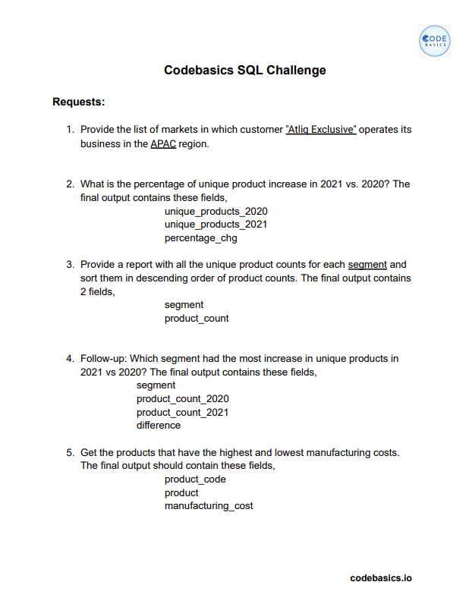

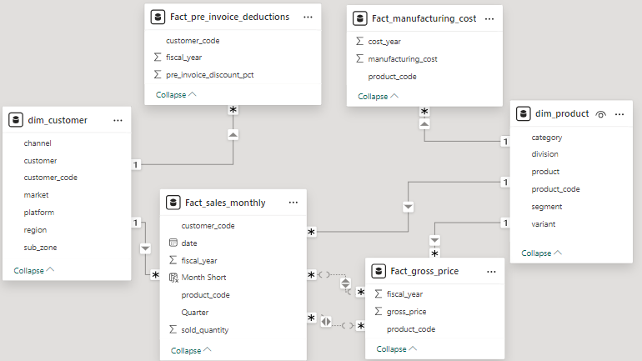
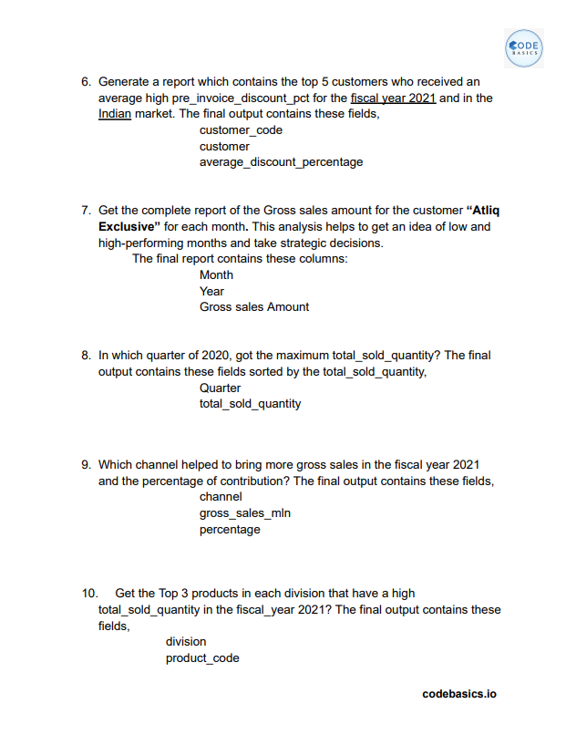
Dataset

Slide 7
Let’s see Ad-hoc requests, query,
Results and insights

Slide 8
Provide the list of markets in which customer "AtliQ Exclusive" operates its business in the APAC region.
Requests 1.
Input
SELECT market
FROM dim_customer
WHERE customer = 'Atliq Exclusive’ AND region = 'APAC’
GROUP BY market
ORDER BY market
;

Slide 9
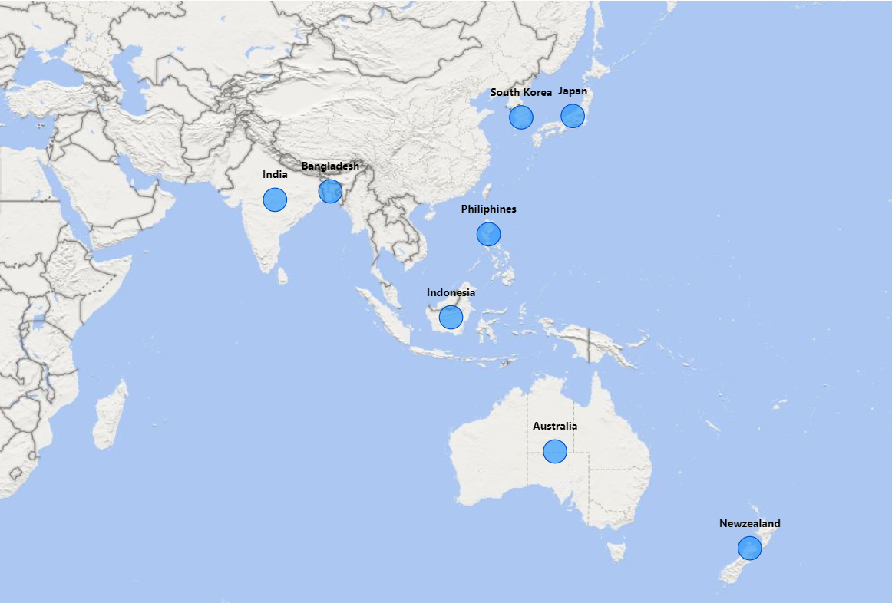
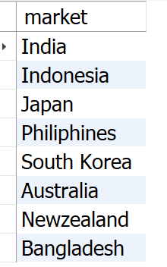
Output
Insight
AtliQ Exclusive operates in eight countries across the APAC region, showcasing a strong presence in the regional market.

Slide 10
What is the percentage of unique product increase in 2021 vs. 2020? The final output contains these fields, unique_products_2020, unique_products_2021, percentage_chg .
Requests 2.
Input
SELECT X.A AS unique_product_2020,
Y.B AS unique_products_2021,
ROUND((B-A)*100/A, 2) AS percentage_chg
FROM (
(SELECT COUNT(DISTINCT(product_code)) AS A
FROM fact_sales_monthly
WHERE fiscal_year = 2020) X,
(SELECT COUNT(DISTINCT(product_code)) AS B
FROM fact_sales_monthly
WHERE fiscal_year = 2021) Y
); ;

Slide 11
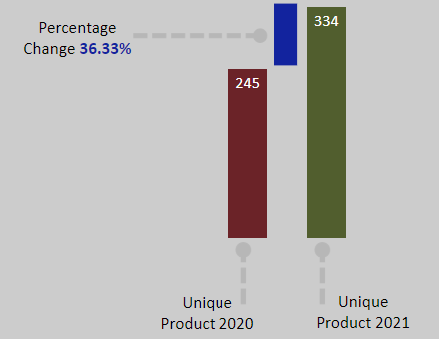
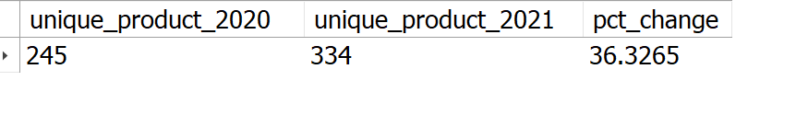
Output
Insights
1.The numbers of unique products increased from 245 in 2020 to 334 in 2021, a 36.33% growth.
2. This growth shows company’s focus on innovation and meeting customer needs.

Slide 12
Requests 3.
Provide a report with all the unique product counts for each segment and sort them in descending order of product counts. The final output contains 2 fields, segment, product_count.
Input
SELECT segment,
COUNT(DISTINCT(product_code)) AS product_count
FROM dim_product
GROUP BY segment
ORDER BY product_count DESC
;

Slide 13
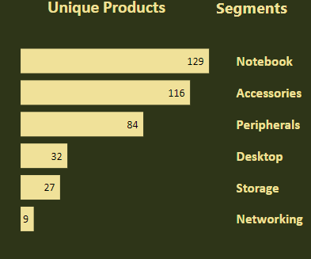
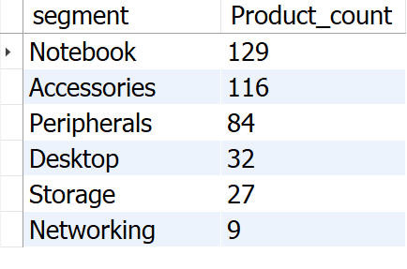
Output
AtliQ excels in the Notebooks, Accessories, and Peripherals segment, making up 82.87% of their product range.
Desktops, Storage, and Networking represent a smaller portion at 17.13%.
In Desktops, Storage, and Networking segment AtliQ should focus on products that align with current customer trends and industry demands.
Insights

Slide 14
Requests 4.
Follow-up: Which segment had the most increase in unique products in 2021 vs 2020? The final output contains these fields, segment, product_count_2020, product_count_2021, difference.
Input
WITH CTE1 AS
(SELECT P.segment AS A, COUNT(DISTINCT(FS.product_code)) AS B
FROM dim_product P, fact_sales_monthly FS
WHERE P.product_code = FS.product_code
GROUP BY FS.fiscal_year, P.segment
HAVING FS.fiscal_year = "2020"),
CTE2 AS
(SELECT P.segment AS C, COUNT(DISTINCT(FS.product_code)) AS D
FROM dim_product P, fact_sales_monthly FS
WHERE P.product_code = FS.product_code
GROUP BY FS.fiscal_year, P.segment
HAVING FS.fiscal_year = "2021“
)
SELECT CTE1.A AS segment, CTE1.B AS product_count_2020, CTE2.D AS product_count_2021,
(CTE2.D-CTE1.B) AS difference FROM CTE1, CTE2
WHERE CTE1.A = CTE2.C ;

Slide 15
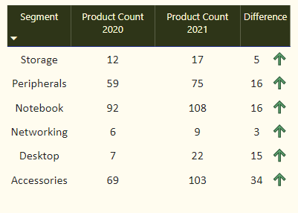
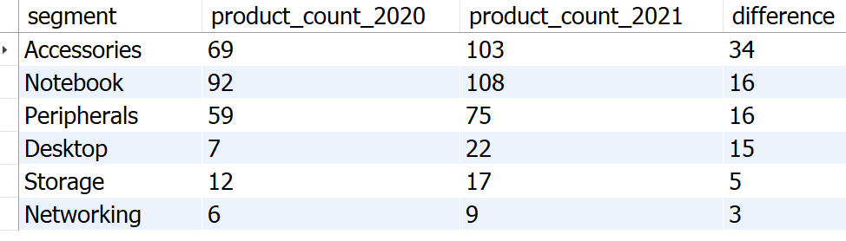
Output
Accessories saw the biggest growth from 2020 to 2021, adding 34 new products.
Desktop product production surged by about 214% during the same period.
3. Storage and Networking segments are producing the least new products from 2020 to 2021.
Insights

Slide 16
Requests 5.
Get the products that have the highest and lowest manufacturing costs. The final output should contain these fields, product_code ,product, manufacturing_cost .
Input
SELECT F.product_code, P.product, F.manufacturing_cost
FROM fact_manufacturing_cost F
JOIN dim_product P
ON F.product_code = P.product_code
WHERE manufacturing_cost
IN (
SELECT MAX(manufacturing_cost)
FROM fact_manufacturing_cost
UNION
SELECT MIN(manufacturing_cost)
FROM fact_manufacturing_cost
)
ORDER BY manufacturing_cost DESC ;

Slide 17
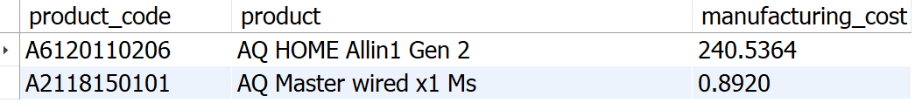
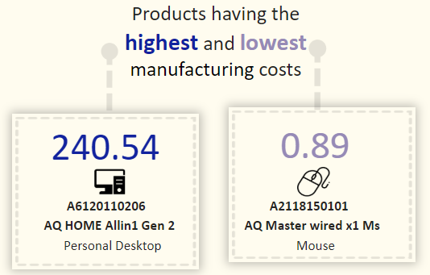
Output

Slide 18
Requests 6.
Generate a report which contains the top 5 customers who received an average high pre_invoice_discount_pct for the fiscal year 2021 and in the Indian market. The final output contains these fields, customer_code, customer, average_discount_percentage .
Input
SELECT c.customer_code, c.customer,
ROUND(AVG(pre_invoice_discount_pct),2) AS average_discount_percentage
FROM fact_pre_invoice_deductions d
JOIN dim_customer c
ON d.customer_code = c.customer_code
WHERE c.market = "India" AND fiscal_year = "2021“
GROUP BY customer_code,c.customer
ORDER BY average_discount_percentage DESC
LIMIT 5;

Slide 19
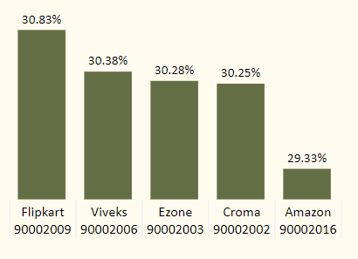
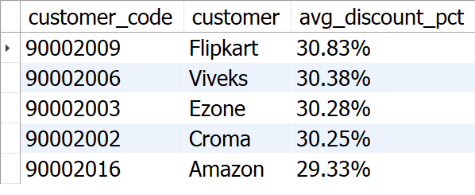
Output
Insights
Flipkart offers the highest average discount at 30.83%.
AtliQ provides similar discounts to its top 5 customers, ranging from 29.33% to 30.83%.

Slide 20
Requests 7.
Get the complete report of the Gross sales amount for the customer “AtliQ Exclusive” for each month. This analysis helps to get an idea of low and high-performing months and take strategic decisions. The final report contains these columns: Month, Year, Gross sales Amount.
Input
SELECT CONCAT(MONTHNAME(FS.date), ' (', YEAR(FS.date), ')') AS 'Month',
FS.fiscal_year,
ROUND(SUM(G.gross_price*FS.sold_quantity), 2) AS Gross_sales_Amount
FROM fact_sales_monthly FS
JOIN dim_customer C
ON FS.customer_code = C.customer_code
JOIN fact_gross_price G
ON FS.product_code = G.product_code
WHERE C.customer = 'Atliq Exclusive’
GROUP BY Month, FS.fiscal_year
ORDER BY FS.fiscal_year
;

Slide 21
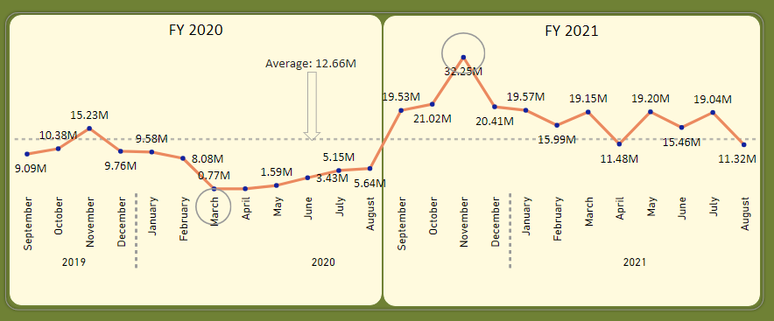
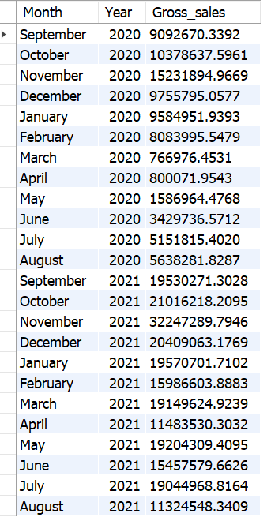
Output
1. Sales were lowest in March, April, and May 2020 due to COVID-19 but started recovering after June.
2. November 2020 saw the highest sales at 15.23 million.
3. Sales grew significantly in 2021 compared to 2020.
4. In 2021, August had the lowest sales at 11.32 million, while November hit a peak of 32.25 million.
Insights

Slide 22
Requests 8.
In which quarter of 2020, got the maximum total_sold_quantity? The final output contains these fields sorted by the total_sold_quantity, Quarter, total_sold_quantity.
Input
SELECT
CASE
WHEN MONTH(date) IN (9,10,11) THEN 'Q1'
WHEN MONTH(date) IN (12,1,2) THEN 'Q2’
WHEN MONTH(date) IN (3,4,5) THEN 'Q3’
ELSE 'Q4’
END AS quarters,
SUM(sold_quantity) AS total_sold_quantity
FROM fact_sales_monthly
WHERE fiscal_year = 2020
GROUP BY Quarters
ORDER BY total_sold_quantity DESC;

Slide 23
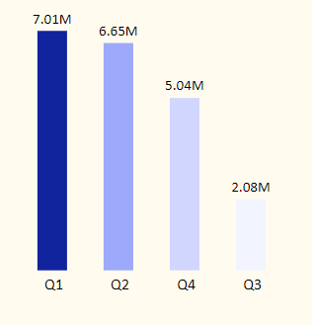
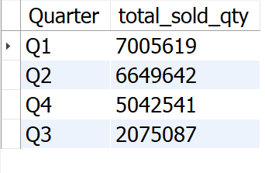
Output
Insights
1. Q1 2020 had the highest sales volume at 7 million units, showing a strong start to the year. 2. Sales dropped sharply in Q3 (March-May) 2020, likely due to the COVID-19 pandemic.

Slide 24
Requests 9.
Which channel helped to bring more gross sales in the fiscal year 2021 and the percentage of contribution? The final output contains these fields, channel, gross_sales_mln, percentage.
Input
WITH temp_table AS (
SELECT c.channel,
SUM(s.sold_quantity * g.gross_price) AS total_sales
FROM fact_sales_monthly s
JOIN fact_gross_price g ON s.product_code = g.product_code
JOIN dim_customer c ON s.customer_code = c.customer_code
WHERE s.fiscal_year = 2021
GROUP BY c.channel
ORDER BY total_sales DESC)
SELECT channel,
ROUND(total_sales/1000000,2) AS gross_sales_in_millions,
ROUND(total_sales/(SUM(total_sales) OVER())*100,2) AS percentage
FROM temp_table ;

Slide 25
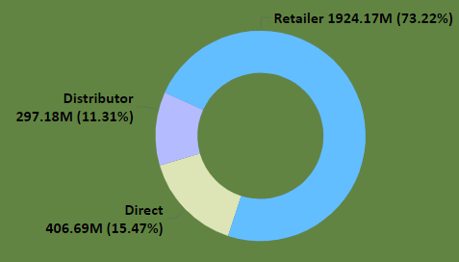
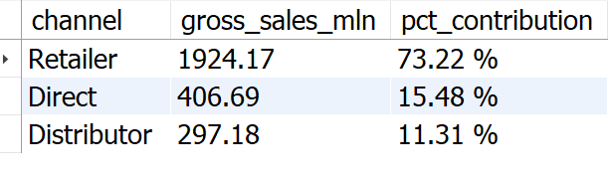
Output
Retailers drive most of AtliQ's sales, making up 73.22% of total gross sales.
Direct and distributor channels contribute 26.79%.
Insights

Slide 26
Requests 10.
Get the Top 3 products in each division that have a high total_sold_quantity in the fiscal_year 2021? The final output contains these fields, division product_code product total_sold_quantity rank_order.
Input
WITH temp_table AS (
SELECT division,
s.product_code,
CONCAT(p.product," ", "(",p.variant,")") AS product ,
SUM(sold_quantity) AS total_sold_quantity,
RANK() OVER (PARTITION BY division ORDER BY sum(sold_quantity) DESC) AS rank_order
FROM fact_sales_monthly s
JOIN dim_product p ON s.product_code = p.product_code
WHERE fiscal_year = 2021
GROUP BY division, s.product_code, p.product, p.variant
)
SELECT * FROM temp_table
WHERE rank_order IN (1,2,3);

Slide 27
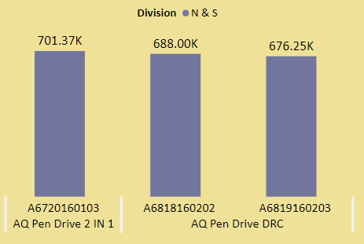
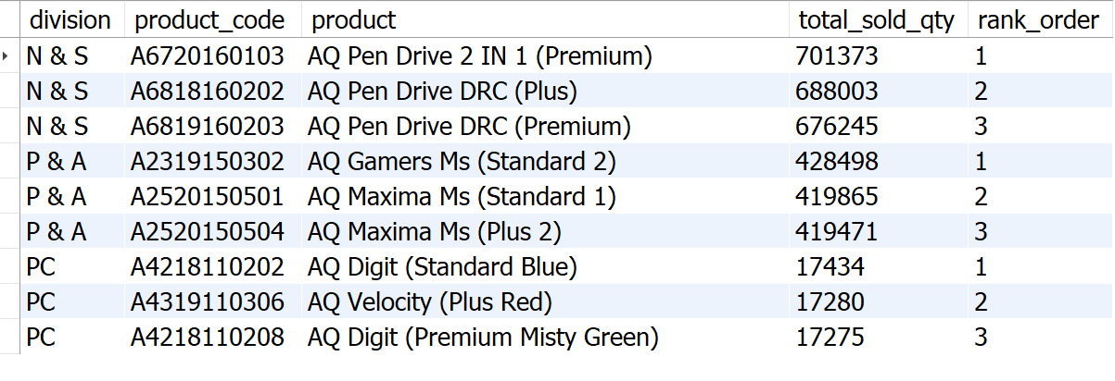
Output
Insights
1. In the N&S division, pen drives dominate the top three spots. 2. The P&A division's top three products are all mice. 3. The PC division's bestsellers are personal laptops.

Slide 28
Recommendations
Prioritize growth in the Desktops, Storage, and Networking segment to expand market share.
Leverage multi-channel marketing for broader reach and engagement.
Combine competitive pricing with compelling promotions to attract and retain customers.
Actively incorporate customer feedback to drive continuous improvement.
Invest in sales team training to enhance performance and achieve business goals.

Slide 29
Thank you For watching !

